Slide 1


THE RISK OF VISUALIZING RISK
How mental health visualizations can mislead clinicians, patients, and the public

Slide 2


Why risk visualization matters in mental health
Making informed decisions about mental health and MH care
Clinicians use graphs to decide treatment plans
Clients interpret therapy progress to stay motivated
Policymakers allocate funding based on risk trends and prevalence statistics
When visuals are misleading or misinterpreted, they distort the perception of risk and mental health trends

Slide 3



HUMAN FACTORS
in Misinterpreting Mental Health Risk Graphics
COGNITIVE BIASES
PERCEPTUAL CHALLENGES
EMOTIONAL FACTORS
How we interpret, react to , process, and evaluate visual data
How we perceive, organize, and assign meaning to visual elements in data
How we respond, engage with, and form judgments about data based on visual and affective cues

Slide 4
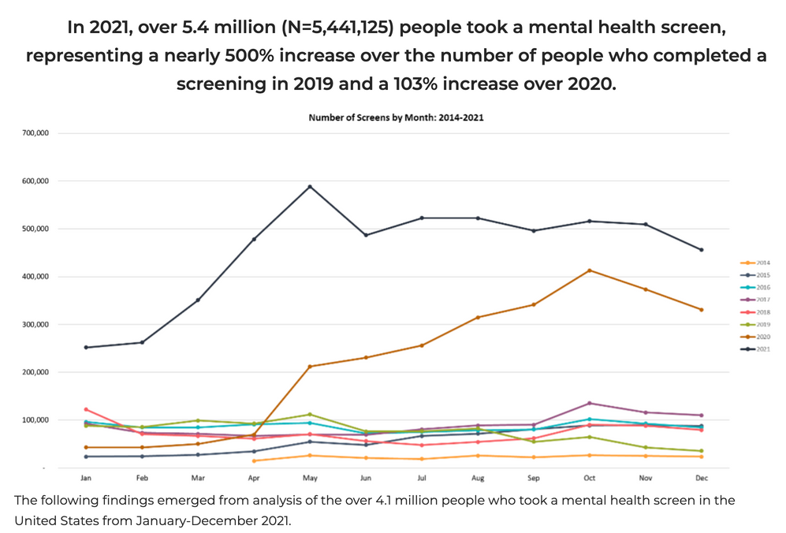
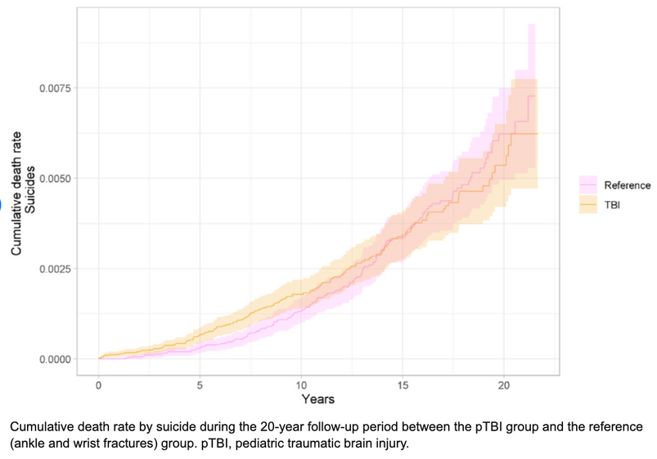
COGNITIVE BIASES
How Mental Shortcuts Lead to Misinterpretation
AVAILABILITY HEURISTIC
FRAMING EFFECT
VISUAL PITFALLS:
Isolated spikes & Truncated Y-axes
VISUAL PITFALL:
Cumulative Graphs
Mental Health America https://mhanational.org/mental-health-and-covid-19-april-2022-data

Slide 5
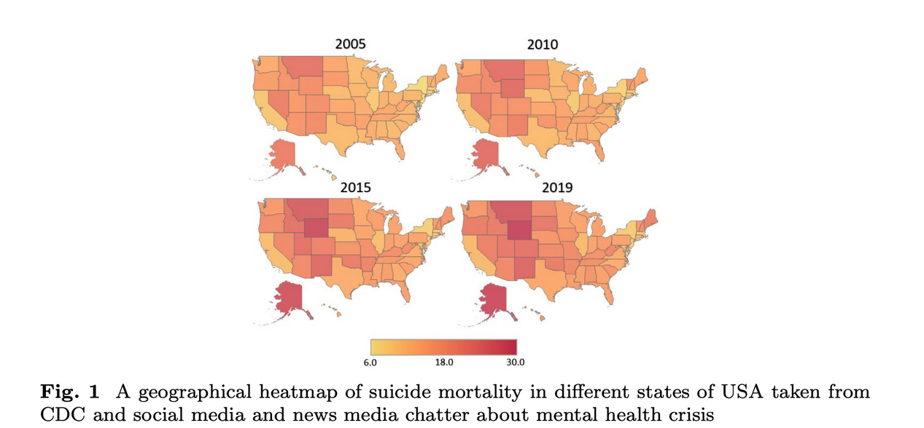
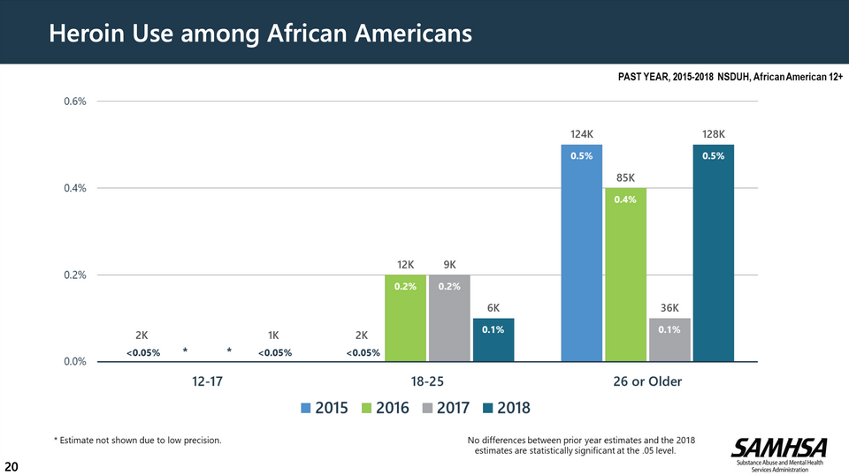
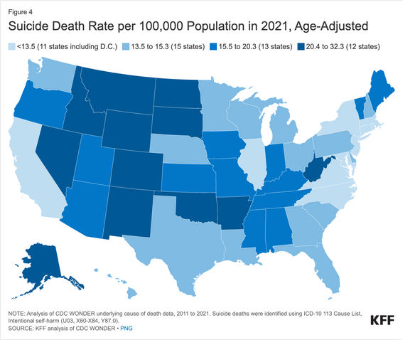
PERCEPTUAL CHALLENGES
Why Our Brains Struggle with Certain Visual Features
MAGNITUDE PERCEPTION
COLOUR PSYCHOLOGY
VISUAL PITFALL:
Distorted Scaling
VISUAL PITFALL:
Heat Maps

Slide 6
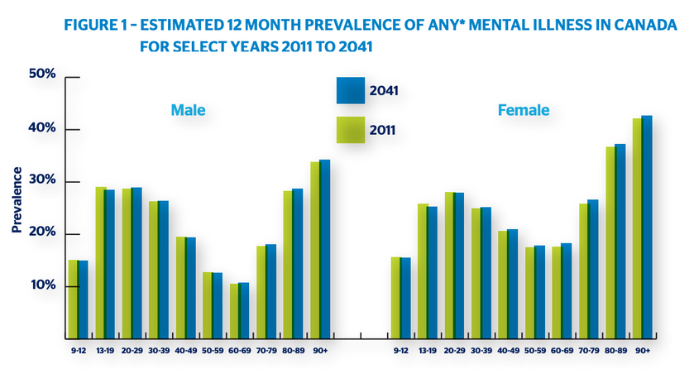
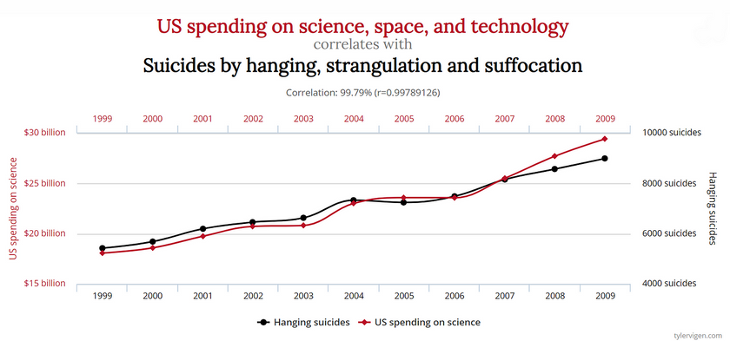
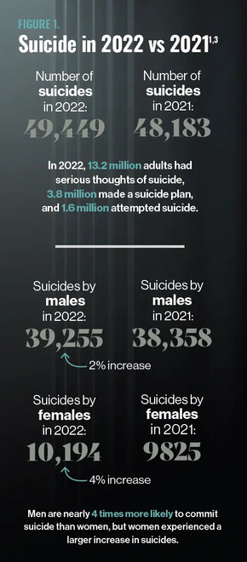
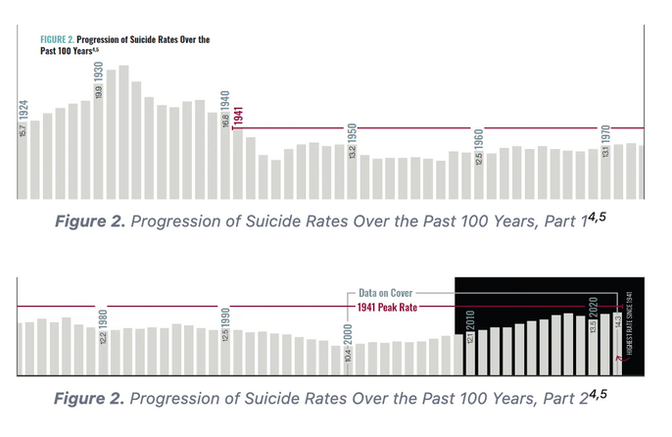
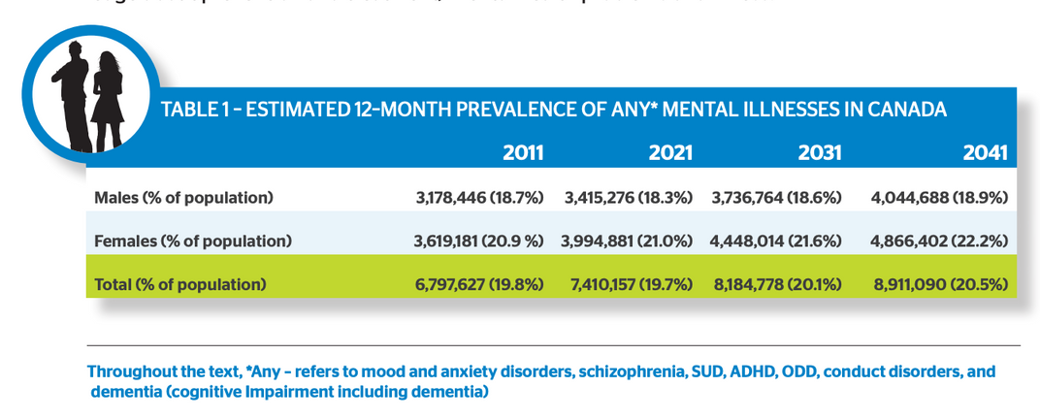
EMOTIONAL FACTORS
How Visual Design Triggers Fear, Urgency, and Misjudgment
FEAR-BASED INTERPRETATION
COLOUR PSYCHOLOGY
ILLUSION OF CAUSALITY
VISUAL PITFALL:
Cherry-Picked Timeframes
VISUAL PITFALL:
Dramatic Colouring
VISUAL PITFALL:
Dual-Axis Graphs

Slide 7




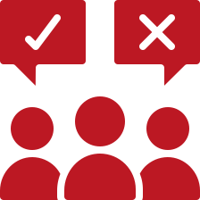
Potential Consequences of Misinterpreting Mental Health Visuals
PUBLIC PANIC & MISINFORMATION
TRUST IN MH INTERVENTIONS
MH STIGMA
MISALLOCATION OF MH RESOURCES
POOR POLICY DECISIONS

Slide 8
Discussion Questions
Do you think fear-based data visualizations (e.g., red-heavy suicide maps, dramatic spikes) are ever justified if they increase awareness of an issue? Why or why not?
Do you think misleading data visualizations are usually intentional (exploiting “human factors”, or are they just the result of poor design choices?
What are some key things people should look for to spot a misleading mental health visualization?

